Slide 1



Bajaj Institute of Technology, Wardha
Department of Computer Engineering
Major Project -I (BTCOS708)
AURA – Adaptive User Responsive Assistant
Project Members
Guided By:
Prof. Sheetal Kale
1.Abhishek Wake (2246491245108) 2.Moin Chavan (22464912450103)
3.Gufrana Sayyad (2246491245086)
4. Dipti Khadagi (2246491245073)

Slide 2
1. Introduction
Problem Statement
Users perform repetitive manual tasks (open apps, browse, control devices).
Existing voice assistants lack local system-level control and custom automation.
There’s a need for a personal, offline-capable, AI-powered assistant.
Proposed Concept
AURA listens for “Hey AURA” and performs system, web, and IoT automation.
Combines Speech Recognition, OpenAI GPT, and Text-to-Speech (TTS).
Outcome
An intelligent, voice-activated ecosystem for hands-free, AI-based productivity.

Slide 3
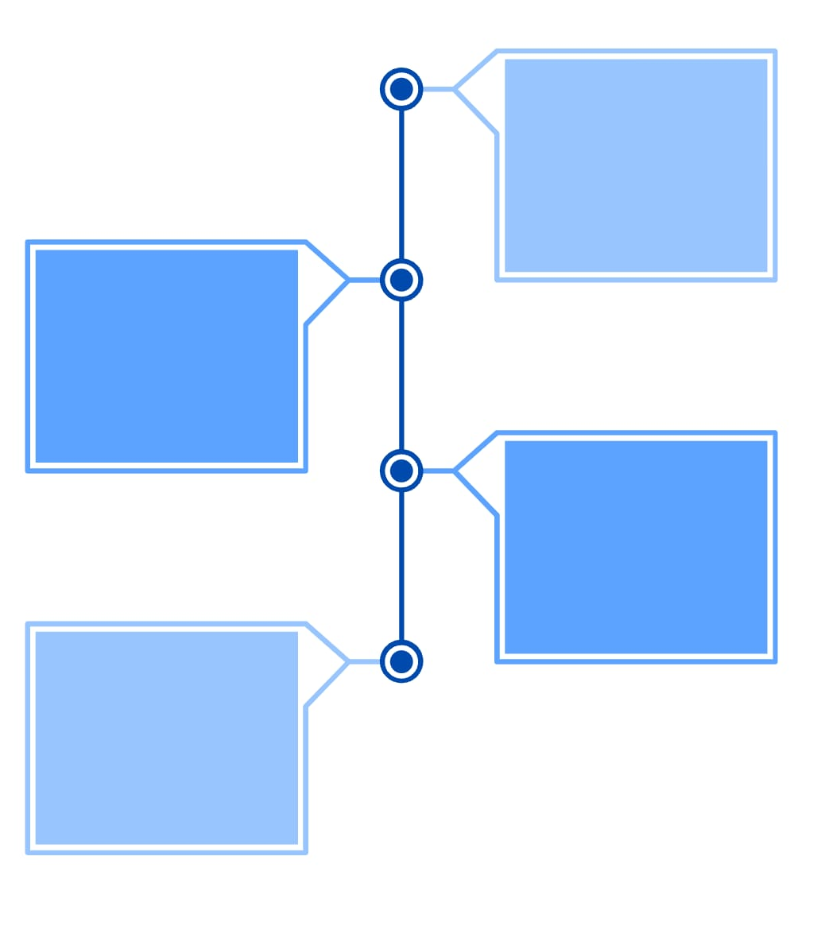
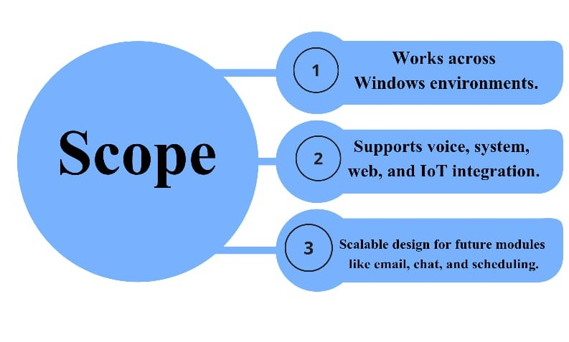
2. Objectives & Scope of Project
Objectives
Build a voice-activated personal assistant for real-time automation.
Integrate OpenAI GPT for intelligent, context-aware conversation.
Support IoT device control using Sinric Pro APIs.
Run continuously in background with minimal resources.

Slide 4


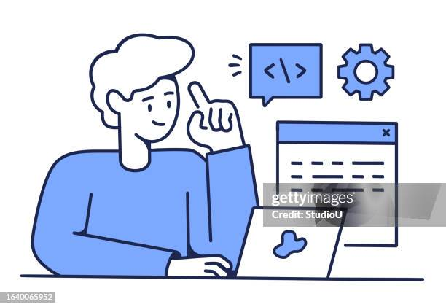

3. Stakeholders
Primary Stakeholders:
Students & professionals
Secondary Stakeholder:
System Developers (Project Team)
Faculty / Evaluators
Tertiary Stakeholder:
Academic Institution
Notes:
1.7.2013
4
‹#›

Slide 5
4. Literature Survey.
Paper Title & Year | Authors | Methods Used | Key Findings / Gaps
Transforming Text Generation in NLP (2023) | G. Alomari et al. | GPT-based Transformer trained on Twitter data using AdamW and dropou | Achieved coherent text generation; gap in large-scale and multilingual training
AI-Powered Personal Assistants (2024) | A. Blessing, J. Micheal, J. Joseph | Literature review on NLP, ML, and IoT in assistants like Alexa & Siri. | Improves productivity; issues in privacy, context understanding, and over-reliance.
IoT Based Smart Home Automation (2023) | H. S. Ogenyi | NodeMCU ESP8266 with Android App & Google Assistant using Arduino IDE | Cost-effective automation; lacks scalability and strong security
Automation in Workday Using Python-Selenium (2022) | J. Jhurani | Python Selenium scripts for automating HR workflows. | Saves time and reduces errors; needs better data security and UI adaptability.
Personal A.I. Desktop Assistant (2023) | R. Joshi et al. | Python voice assistant using NLP, speech recognition, and APIs. | Performs basic tasks via voice; lacks learning ability and context awareness.
Speech Recognition with Deep Learning (2024) | D. Al-Fraihat et al. | Review of CNN, RNN, Transformer models for speech tasks. | Hybrid DL models best; gap in low-resource and multilingual systems.
Authors
Methods Used
Key Findings / Gaps
Paper Title & Year
7

Slide 6
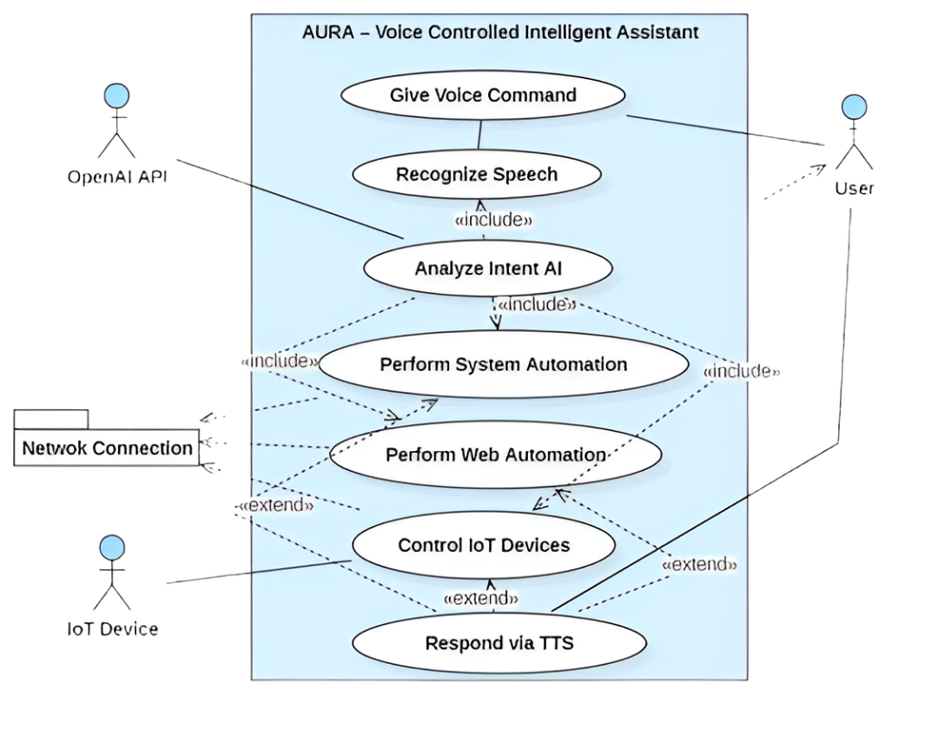
5. Proposed Solution
8

Slide 7
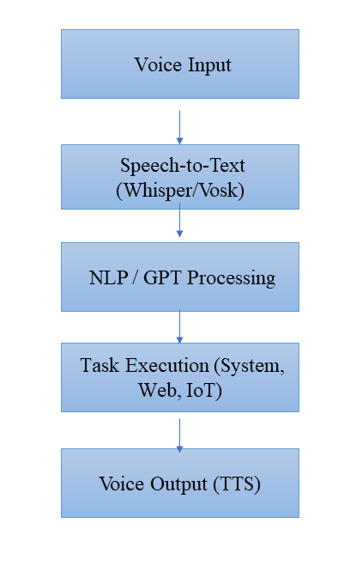
6. Methodology
Requirement Analysis → Identify automation needs, study existing assistants.
System Design → Layered architecture (Input Layer→ Speech-to-Text (STT) Layer→ AI / NLP Layer→ Task Manager layer→ Output layer).
Implementation → STT (Whisper/Vosk), NLP (LLMs), Digital & IoT task execution, TTS feedback.
Testing & Evaluation → Accuracy, response time, task success rate in different scenarios.

Slide 8
7. Technologies Used
Category | Tools / Libraries
Speech Recognition | SpeechRecognition, vosk, Google API, Sphinx
Text-to-Speech | pyttsx3
AI Engine | OpenAI GPT, JSON intent parsing
System Automation | pyautogui, psutil, pycaw, subprocess, os
Web Automation | selenium, webbrowser, urllib
IoT Integration | sinricpro SDK
Notes:
1.7.2013
7
‹#›

Slide 9
8. Core Features
Wake word activation – “Hey AURA”
Multi-engine speech recognition
AI-driven conversation (OpenAI GPT)
Complete system automation (apps, tools, volume, brightness)
Web automation (YouTube, Gmail, Google search)
IoT smart device control (via Sinric Pro)
Natural voice responses through TTS

Slide 10
9.Implementation Highlights
Optimizations
3× Faster Execution: Caching and pattern matching
Reduced API Calls: Common commands processed locally
Async Processing: Thread-based non-blocking tasks
Error Recovery: Automatic restart after failures
Sample Commands
System: “Hey AURA open calculator”
Web: “Hey AURA search for Python tutorials”
IoT: “Hey AURA turn off light”
Conversation: “Hey AURA what is artificial intelligence?”

Slide 11
10. Future Scope
Personal Productivity Assistant (students, developers, office workers).
Smart Home Hub for controlling appliances via AI, not just “dumb commands.”
Enterprise Use: Office automation (meeting scheduling, reports, device control).
Expansion:
Integration with Notion, Trello, Jira for project management. AI “macro creator” (learns your habits, builds custom workflows).

Slide 12
11. Conclusion
The project AURA – AI Responsive Assistant​ integrates AI and IoT to automate both digital tasks like emails, browsing, and coding, and physical tasks such as controlling lights, fans, and studio setups. With personalized workflows like study mode and sleep mode, it helps users save time, reduce effort, and boost productivity.
AURA is scalable and adaptable, making it easy to add new devices and applications. By combining speech recognition, AI reasoning, and automation tools, it moves a step closer to creating a real-world assistant for students, professionals, and smart homes.

Slide 13
12. References
[1] G. Alomari, I. Aljrah, M. Aljarrah, A. Aljarah, and B. Aljarah, “Transforming Text Generation in NLP: Deep Learning with GPT Models and 2023 Twitter Corpus Using Transformer Architecture,” Int. J. Recent Innov. Trends Comput. Commun., vol. 11, no. 9, pp. 3139–3145, 2023.
[2] A. I. Blessing, J. Micheal, and J. Joseph, “AI-Powered Personal Assistants: Enhancing Daily Life,” ResearchGate Preprint, Sept. 2024.
[3] H. S. Ogenyi, “IoT Based Smart Home Automation System Using ESP8266,” B.Eng. Thesis, Dept. Telecommunication Eng., Federal Univ. of Technology, Minna, Nigeria, 2023.
[4] J. Jhurani, “Automation in Workday Using Python-Selenium,” Int. Res. J. Eng. Technol. (IRJET), vol. 9, no. 12, pp. 102–106, 2022.
[5] R. Joshi, S. Kar, A. W. Bamud, and M. T. R., “Personal A.I. Desktop Assistant,” Int. J. Sci. Res. Eng. Manage., vol. 7, no. 2, pp. 55–60, 2023.
[6] D. Al-Fraihat, Y. Sharrab, F. Alzyoud, A. Qahmash, M. Tarawneh, and A. Maaita, “Speech Recognition Utilizing Deep Learning: A Systematic Review of the Latest Developments,” J. Appl. Artif. Intell., vol. 38, no. 4, pp. 250–259, 2024.

Slide 14


Thank You.
15

